Slide 2
Formal Correspondence

Slide 3
Business correspondence means the exchange of information in a written format for the process of business activities.
Business correspondence can take place between organizations, within organizations or between the customers and the organization.
The correspondence refers to the written communication between persons.

Slide 4
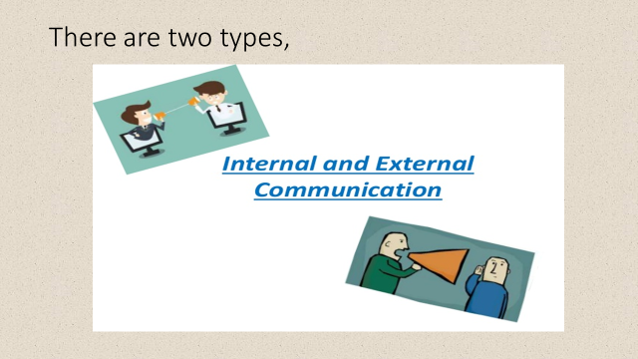
Let’s look at the type of communication in business

Slide 5
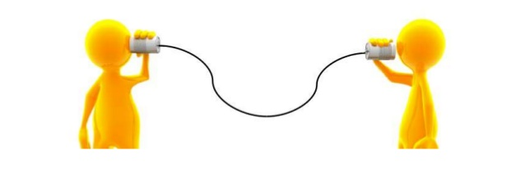
INTERNAL COMMUNICATION
It is the information exchange within the organization.
Messages can be exchanged via personal contact, telephone, e-mail.
Helps employees in performing their work, developing a clear sense of organization mission and identifying and promptly dealing with potential problems.

Slide 6

EXTERNAL COMMUNICATION
Communication that is occurred among the organizations is called the external communication
Organizations communicate with the outside world on a daily basis.
External communication can be formal and informal.

Slide 7

Point to be noted
Internal communication can be formal and informal.

Slide 8
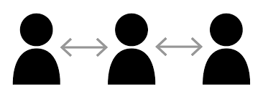
FORMAL INTERNAL COMMUNICATION
There are three modes of formal communication within the organization

Slide 9
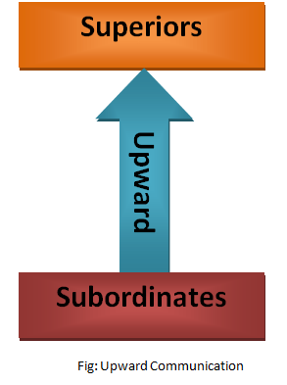
Upward communication: Communication-flows from employees to executives, providing insight into problems, trends, opportunities, grievances, and performance-thus, allowing executives to solve problems and make intelligent decisions.

Slide 10
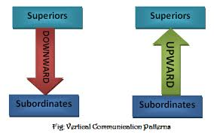
Downward communication: Communication-Flows from executives to employees conveying executive decisions and providing information that helps employees do their jobs

Slide 11
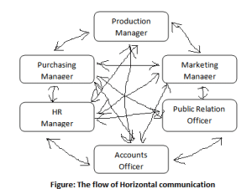
Lateral/horizontal communication: Communication-Flows between departments to help employees share information, coordinate tasks, and solve complex problems.

Slide 12
Now let’s go back to the samples of letter
Sample 1
Dear Mr. Behrens, CEO,
In regard to your request on January 11, the IT department have evaluated the need for new company wide computing equipment. I have enclosed the following report analyzing cost, efficiency and productivity of the 4 proposed brands.
Based on their findings, IT concur that a new line of computers will indeed benefit the company overall. They recommend contracting with Dell to implement the 2013 Office Suite range.
Regards,

Slide 13
Sample 2
Dear Ms. Edwards:
I wanted to take this opportunity to thank you for the excellent job you did in arranging the financial aid for our project. We appreciate the fact the you made yourself available for discussion seven days a week. We were impressed by your thorough knowledge of financing and investment banking.
We have been dealing for our new financing institution for about a week now. The advantages of association with this institution are already apparent. I feel as though we have taken a quantum leap towards the progress.
I would not hesitate to retain your services and to recommend your firm to any company seeking the best representation.
Sincerely yours,
J.B. Watson

Slide 14
The Types of Correspondence
Memorandum
Formal letters

Slide 15
What is a memorandum?
It is considered as an “inside” correspondence.
It is written to someone in your company

Slide 16
Why do we use memos?
To save something as a written record
To save time
Inexpensive

Slide 17
What are the purposes of memo?
To inform
To inquire
To report
To remind
To promote goodwill

Slide 18
What is the tone of memo?
Informal communication
Writer is likely to be familiar with the reader within organization
A very formal tone might sound intimidating

Slide 19
How to structure a memo?
It has following parts:
Heading
Opening
Body
Closing

Slide 20
Heading
To: (Name and designation of the sender)
From: (Name and designation of the Recipient)
Date: (Complete and current)
Subject: (Topic/subject of memo)

Slide 21
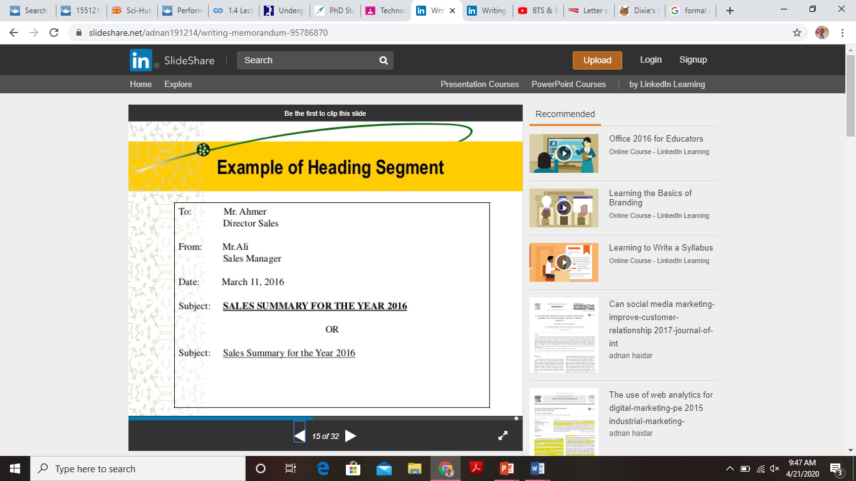

Slide 22
Opening
State the purpose of the memo, give facts.

Slide 23
Body
Single spaced
It describes the main idea of memo, includes details on the said topic

Slide 24
Closing
Make a courteous closing statement
Do not use “yours sincerely”

Slide 25
Examples of Memo

Slide 26
To: All Staff
From: The Manager
Date: May 27, 2010
Subject: Inappropriate use of time on Google Doodle games
Coworkers,
It has come to my attention that many in the office have been spending time on the Google home page microgames. This memo is a reminder to use your work hours for work.
According to a recent article, the estimated daily cost of people collectively playing these games instead of working is over $120 million—which is calculated based on the daily average increased time spent on the Google home page (36 seconds).
If these estimates are applied to our 600 office employees, this results in a nearly $700 weekly loss.
This is a conservative estimate considering the extensive discussions that occur about beating the office's current high score. The extra cost quickly adds up.
Of course, we don't want you to view our organization as a place of drudgery and draconian rules. I encourage a fun and competitive environment, and I recognize that we certainly won't be profitable if you are unhappy or dissatisfied with your jobs. This is just a reminder to be careful with your use of company time.
Thank you,
The Manager
Example 1

Slide 27
To: Computer Programming Division
From: Vice President Lumbergh
Date: February 19, 2016
Subject: Attaching cover sheets to TPS reports
This is to remind the division that, starting today, we are now filing all Testing Procedure Specification (TPS) reports with new cover sheets.
The reason for this change is simple. In addition to a new format, the cover sheets provide a summary of the report as well as the updated legal copy. The new cover sheets also include Initech's new logo.
Though this change may initially seem like a headache and an extra step, it is necessary to include the new cover sheets due to their updated information. Failing to do so will result in a confusing and inaccurate product delivered to our customers.
Please be sure to follow this new procedure.
Best regards,
Vice President Lumbergh
Example 2

Slide 28
Practice
You are an administrative assistant. You want to tell 10 people about an upcoming computer training seminar. You are attaching a brochure about the seminar from the presenter, but you also need to inform them of the following:
• what the training is for
• who the presenter is, including a brief statement about his/her background
• where the training will be held, including the date and time
• whether or not parking is available
• whether or not lunch and/or any refreshments will be served

